Slide 1

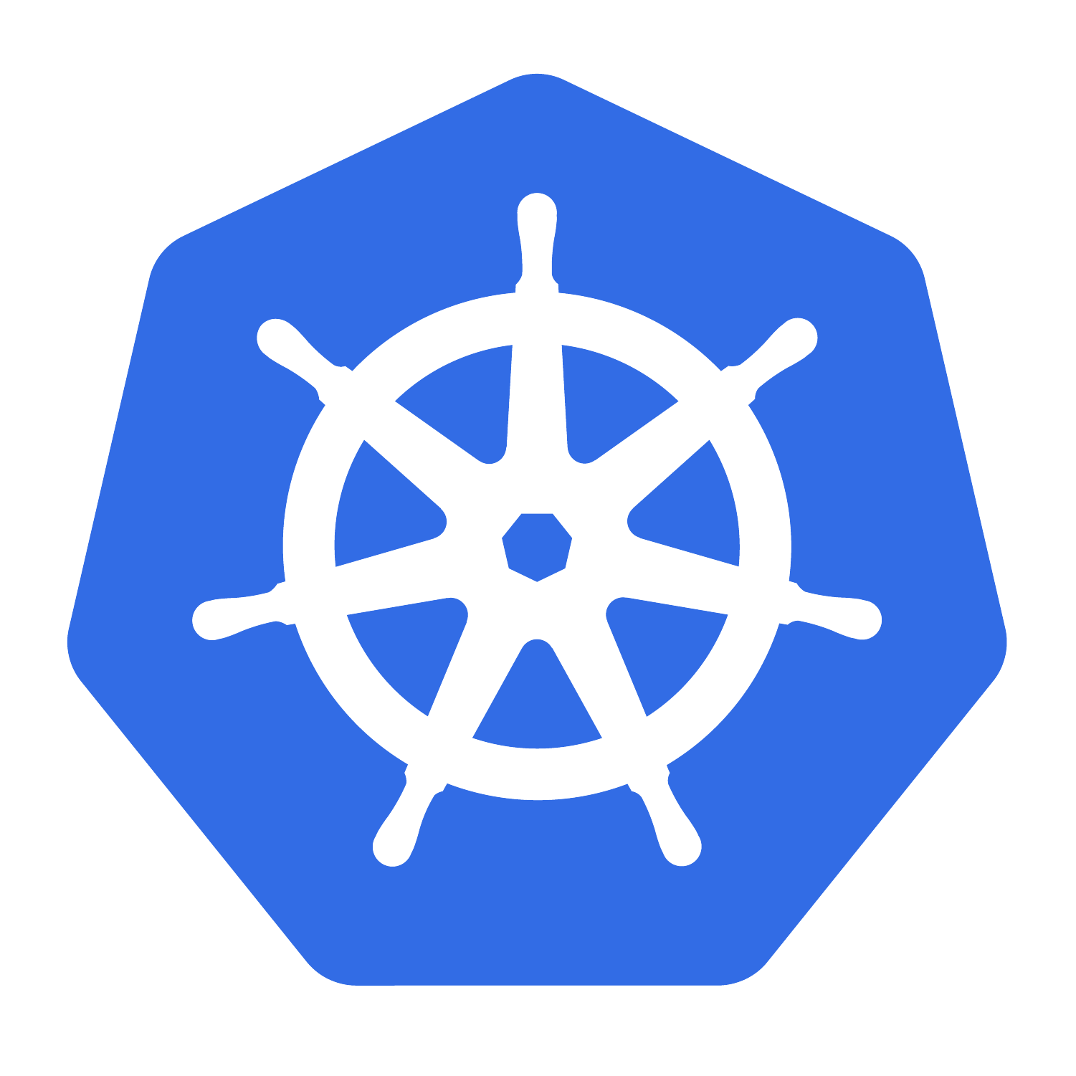
Crossplane: Habilitando Engenharia de Plataforma na sua Infraestrutura
Eduardo Munari
Pedro Ignácio
06/12/2025

Slide 2
Todas as opiniões apresentadas aqui são dos autores e não representam as posições de suas respectivas empresas
All opinions expressed here are those of the authors alone and do not represent their respective organizations

Slide 3

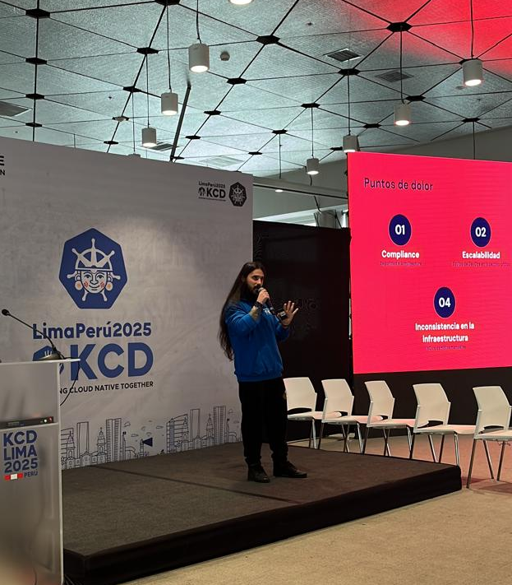






Eduardo
Staff Technical Product Manager @ Stone
Containers && \ Platform Engineering Specialist
Golden Kubestronaut
CNPA + CNPE
KCNA Exam Developer

Slide 4






Pedro
Lead Platform Engineer @ Itaú Unibanco
Cloud Security and Observability specialist
KodeKloud Instructor

Slide 5

Agenda
Plataformas e Engenharia de Plataforma – setando expectativas
Control Planes – conceito e arquitetura
Crossplane – Um framework para construção de control planes
crossplane 101
crossplane pods
managed resource based vs composition based
Crossplane Providers – estendendo a solução
provider 101
provider pods
Crossplane Use Cases – aplicando no dia a dia
environment promotion
abstraindo configurações com environment config
Monitoring Crossplane – lidando com a escala

Slide 6
Plataformas
"A digital platform is a foundation of self-service APIs, tools, services, knowledge and support which are arranged as a compelling internal product."
Evan Bottcher
Fascinante
Irresistível
Cativante
Atraente
Convincente

Slide 7








Engenharia de Plataforma
X

Slide 8
Engenharia de Plataforma
Com base em Engenharia de Software e Confiabilidade, criar plataformas resilientes, atingindo eficiência operacional e financeira, reduzindo a carga cognitiva e evoluindo por meio de feedbacks;
Através de métricas, construir um produto que gera valor por meio de novas funcionalidades, aumentando a agilidade, governança e competitividade da organização.

Slide 9
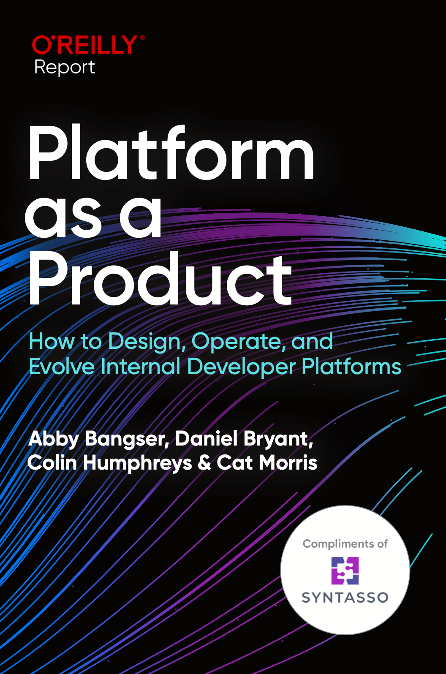
Engenharia de Plataforma
A platform is not just a collection of tools, templates, or workflows.
It is an evolving system that must continuously respond to user
needs. To achieve this, it must be treated not as a project but as a
product.
Colin Humphreys, from Platform as Product O'Reilly Report

Slide 10
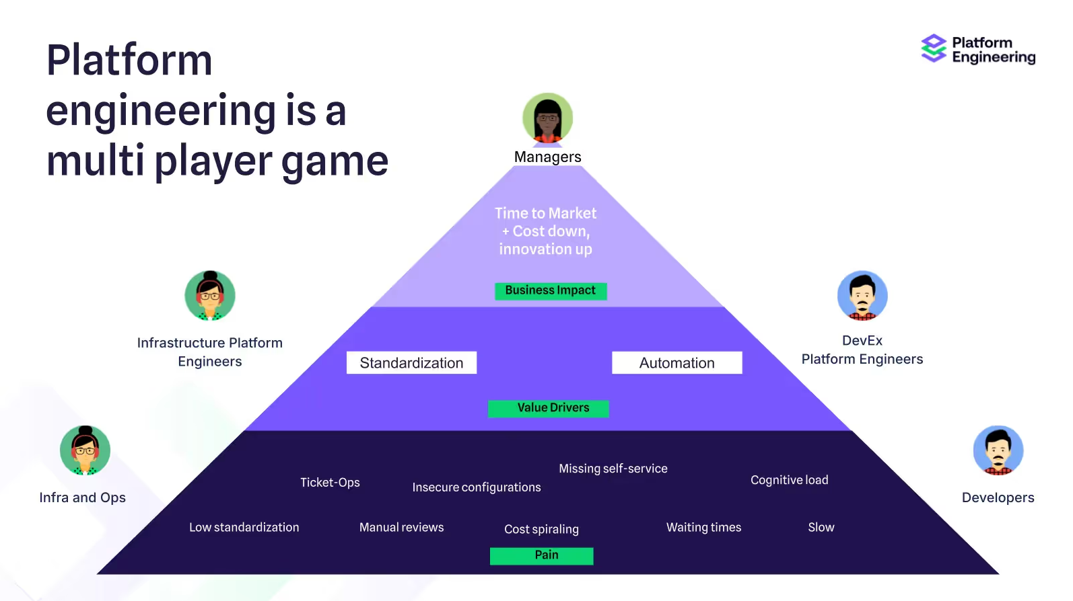
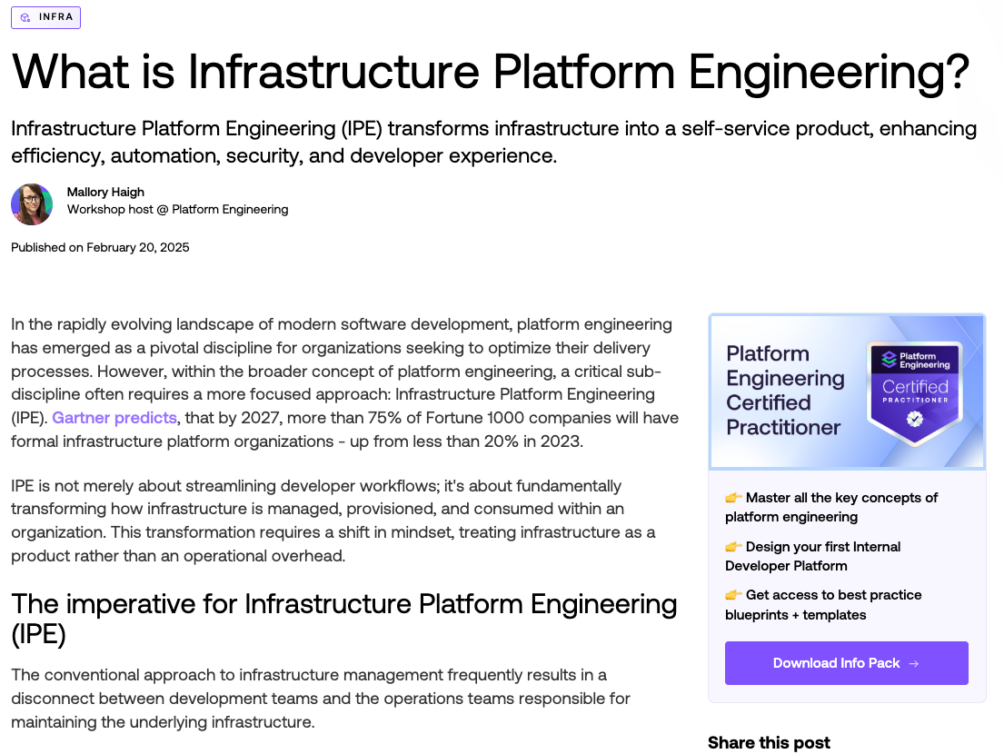
Engenharia de Plataforma
https://platformengineering.org/blog/what-is-infrastructure-platform-engineering

Slide 11
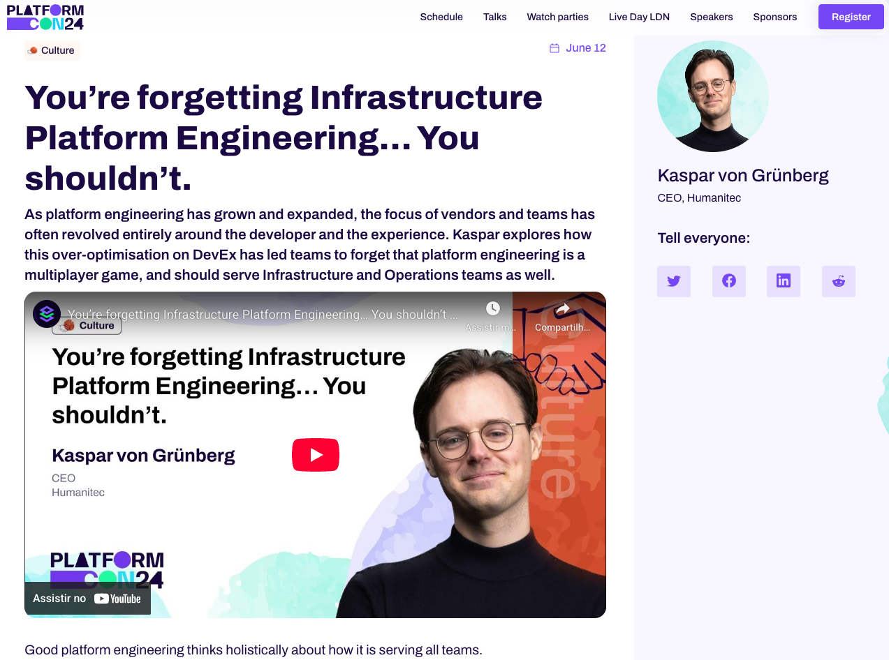
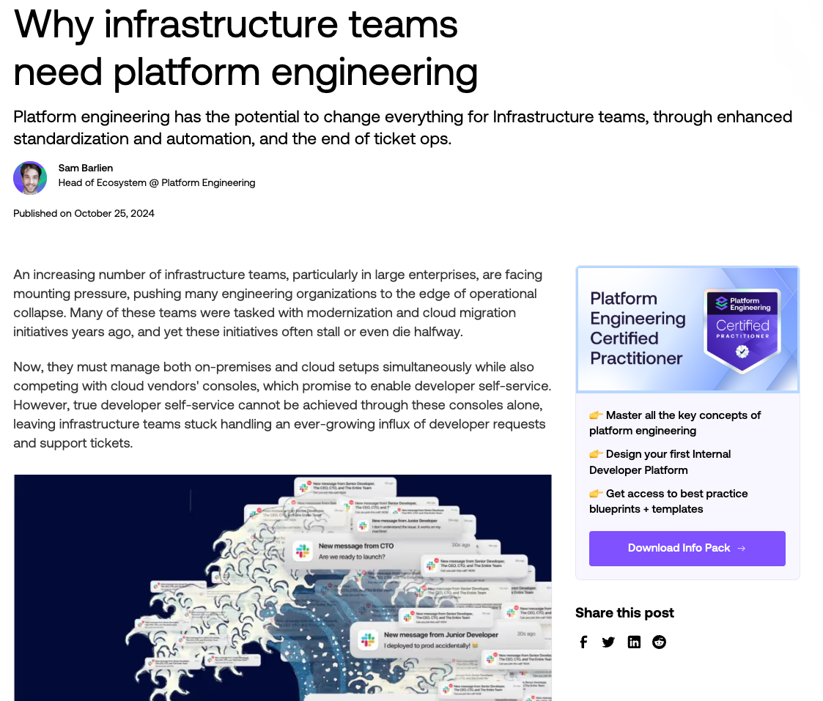
Engenharia de Plataforma
https://2024.platformcon.com/talks/youre-forgetting-infrastructure-platform-engineering-you-shouldnt
https://platformengineering.org/blog/why-infrastructure-teams-need-platform-engineering

Slide 12

Control Planes

Slide 13
Control Planes
“Centralizador” de componentes
Orquestração de serviços
Gestão e manutenção
Padronização

Slide 14
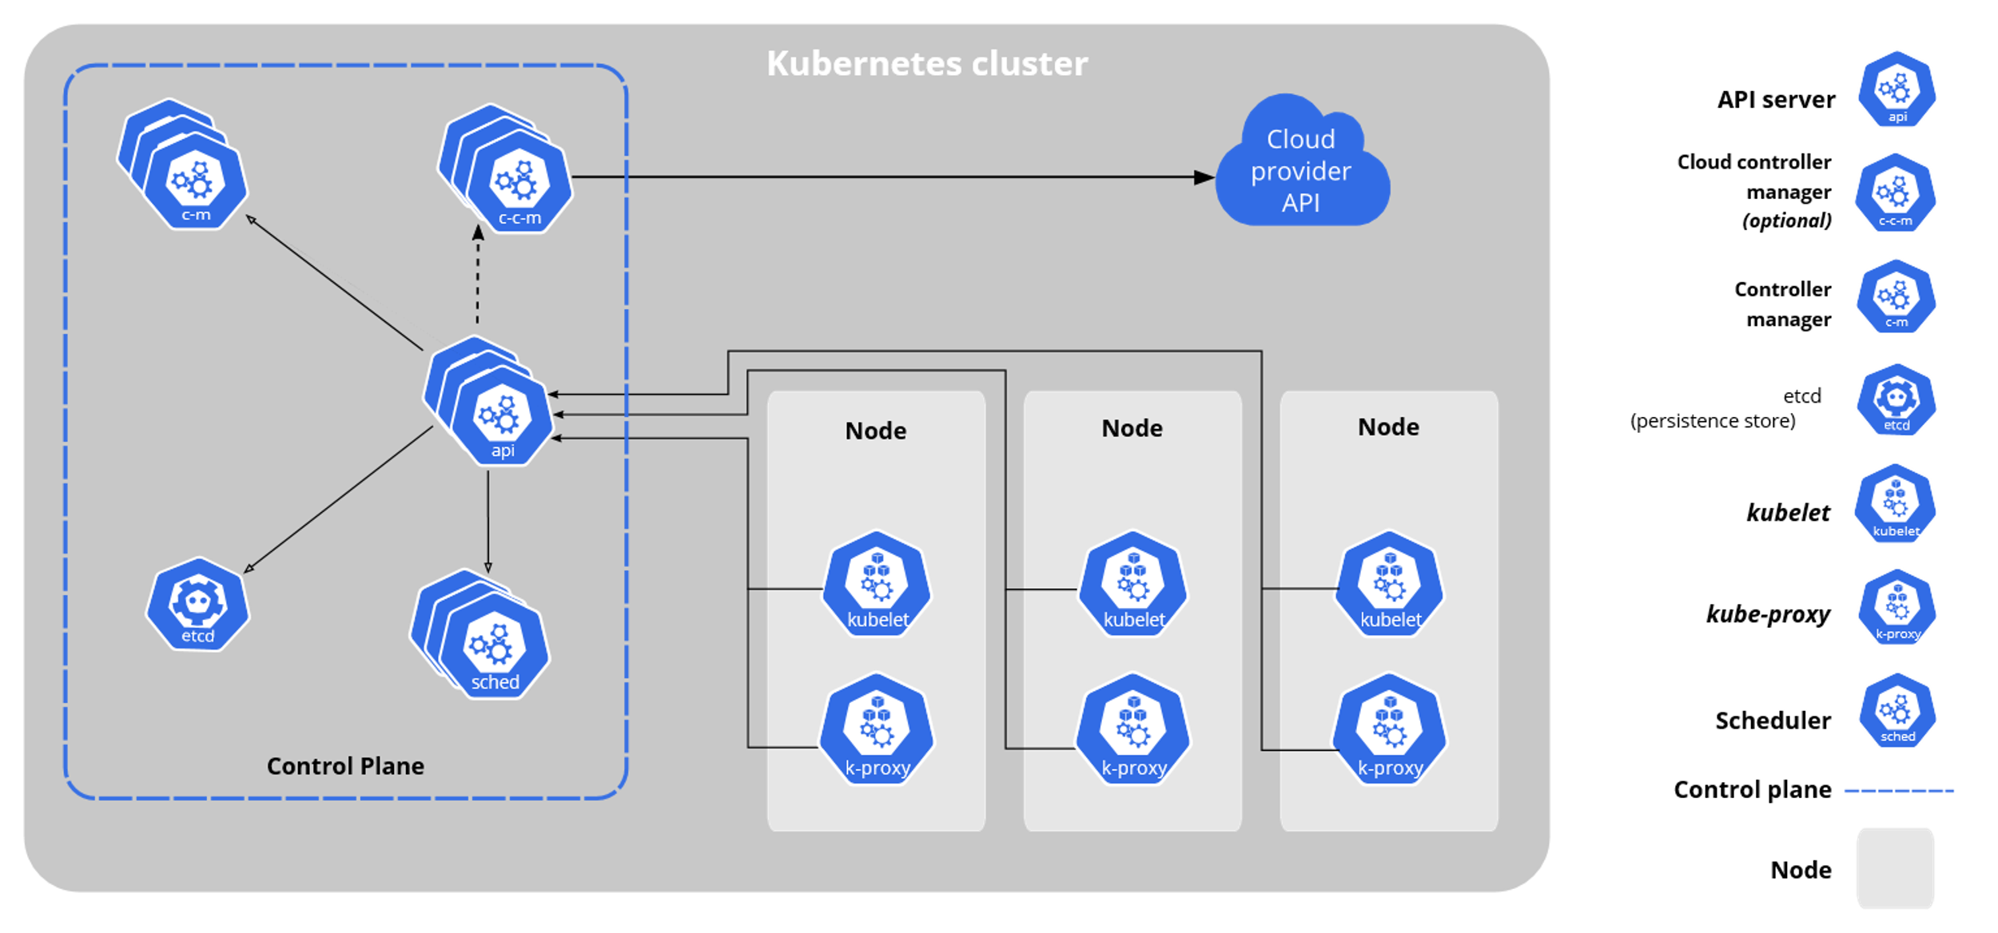
Control Planes - k8s approach

Slide 15
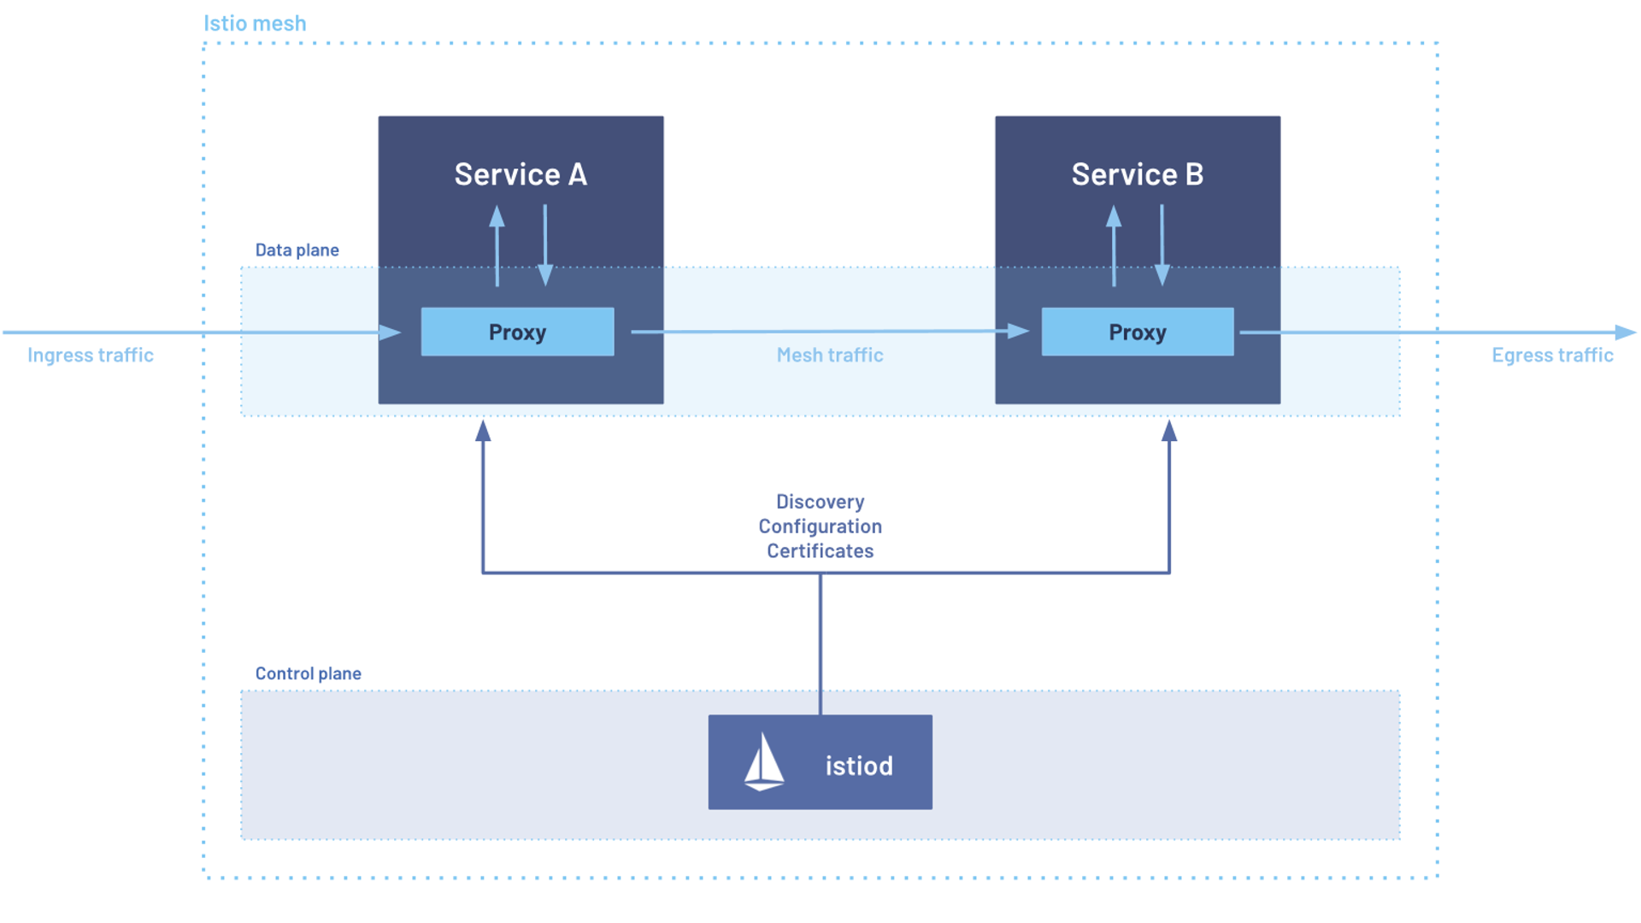
Control Planes - Istio approach

Slide 16
Crossplane
Um framework para construção de control planes!

Slide 17
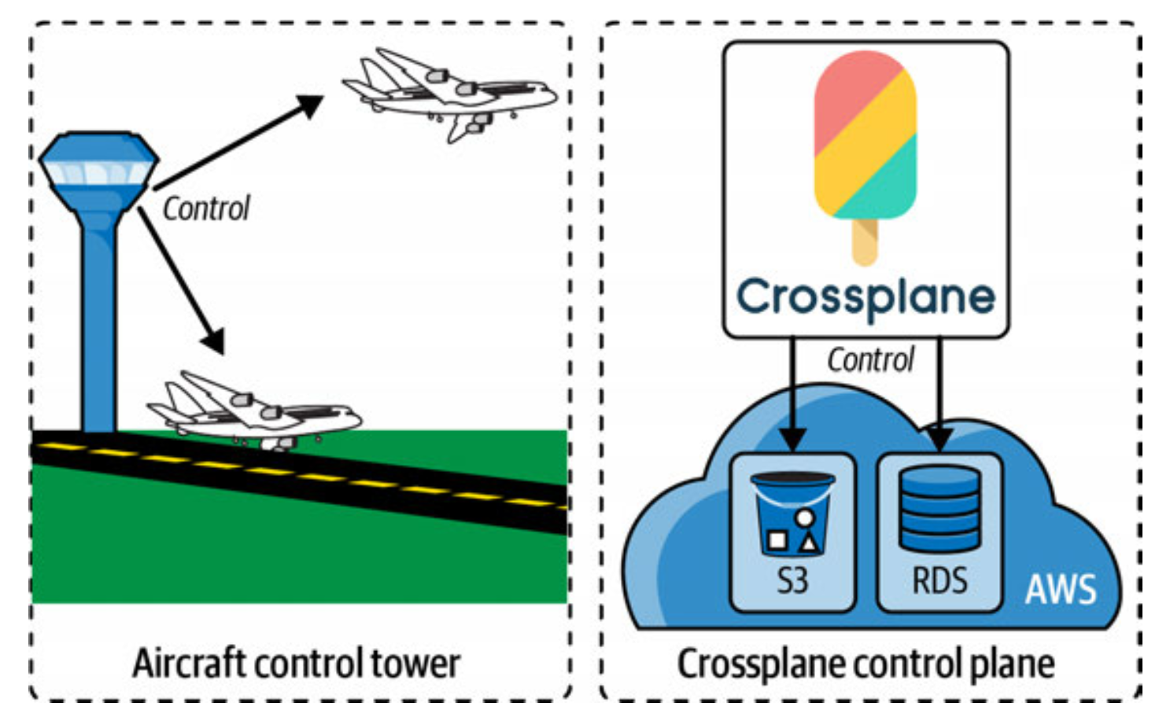
Crossplane 101
Uma extensão do Kubernetes que transforma seu cluster em um control plane universal para gerenciamento de infraestrutura.
Permite o provisionamento, configuração e gerenciamento de recursos de infraestrutura de qualquer provedor.

Slide 18
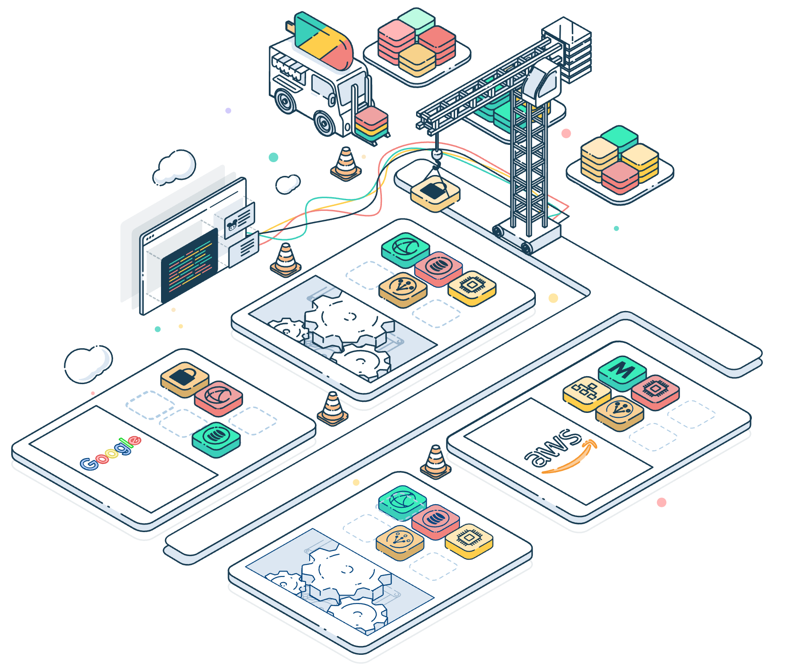
Crossplane 101
Sistema que gerencia o estado desejado vs atual
Define "o que" você quer, não "como" criar
Mantém recursos sincronizados automaticamente
Conecta-se a qualquer API externa
Combina recursos em abstrações de alto nível

Slide 19
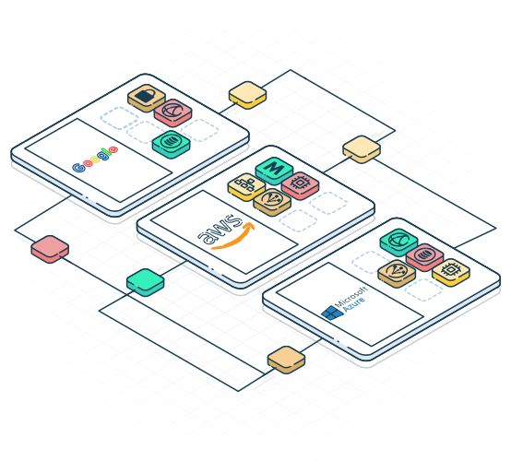
Crossplane 101
Desafios
Como resolve
Scripts Imperativos
APIs Declarativas
Configuration Drift
Reconciliação Contínua
Multi Cloud Complexity
Abstrações
Controle de Acesso
RBAC Nativo
State Management
Stateless

Slide 20

Crossplane 101
Infraestrutura Self-Service
Experiência Consistente
GitOps Ready
Sem Lock-in
Kubernetes Native

Slide 21
Crossplane 101
Claim
User proxy
Composite Resource Definition (XRD)
Composite Resource
Composition
Define o Schema
Instância da API
Implementa a API
Managed Resource
Managed Resource
Managed Resource
Representação do Recurso

Slide 22

Crossplane 101
Claim
tfvars file
Composite Resource Definition (XRD)
variables.tf
Composition
modules.tf

Slide 23
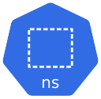





Crossplane Pods
kubernetes cluster
crossplane-system
API Server
Instala
crossplane-pod
initContainer
Events
Observa
Inicia
coreContainer
Reconcilia
Composite Resources e Claims
crossplane-rbac-manager-pod
Gerencia
ClusterRoles
crossplane-pod - controlador principal
crossplane-rbac-manager-pod - gerenciador de permissões

Slide 24
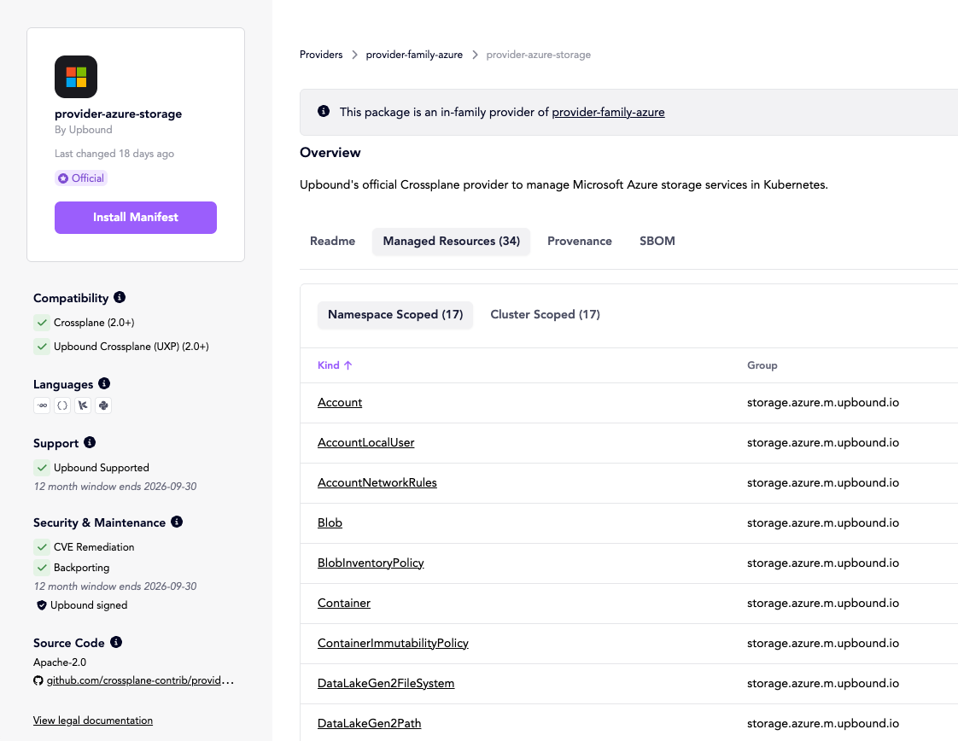
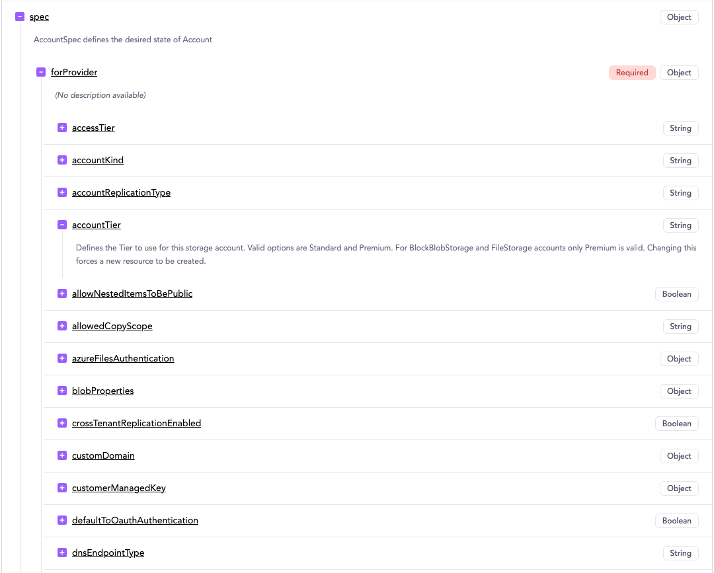
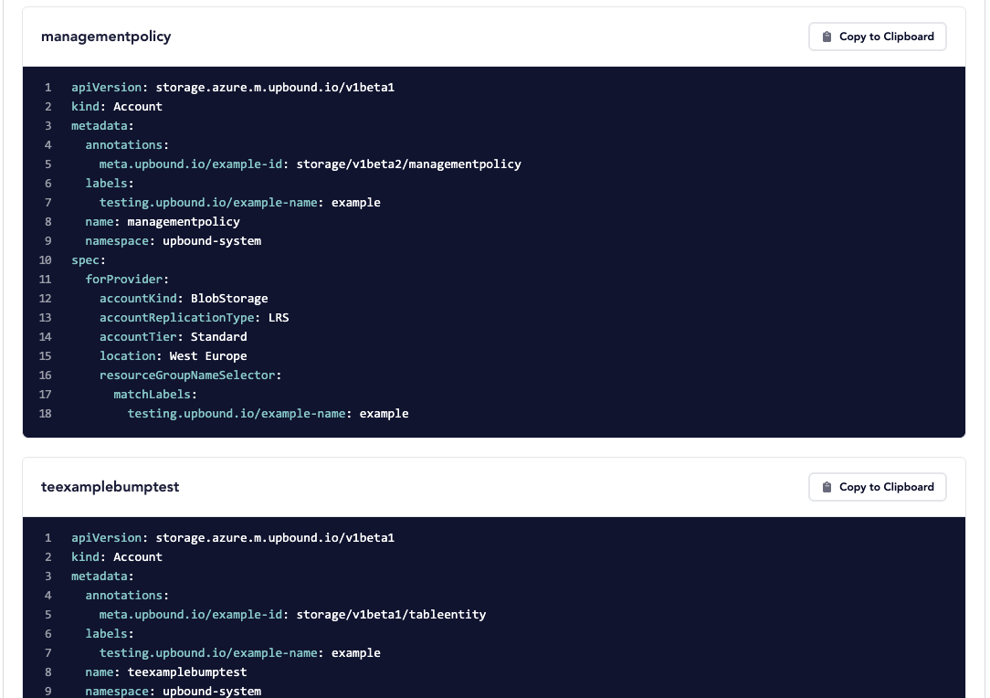
Managed resource based

Slide 25
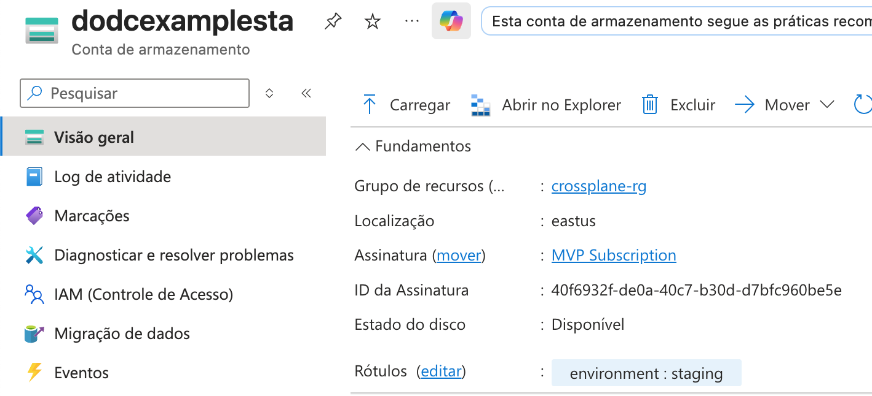
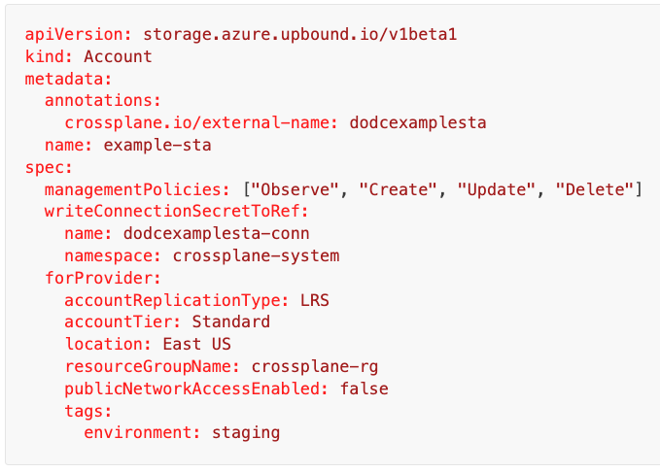
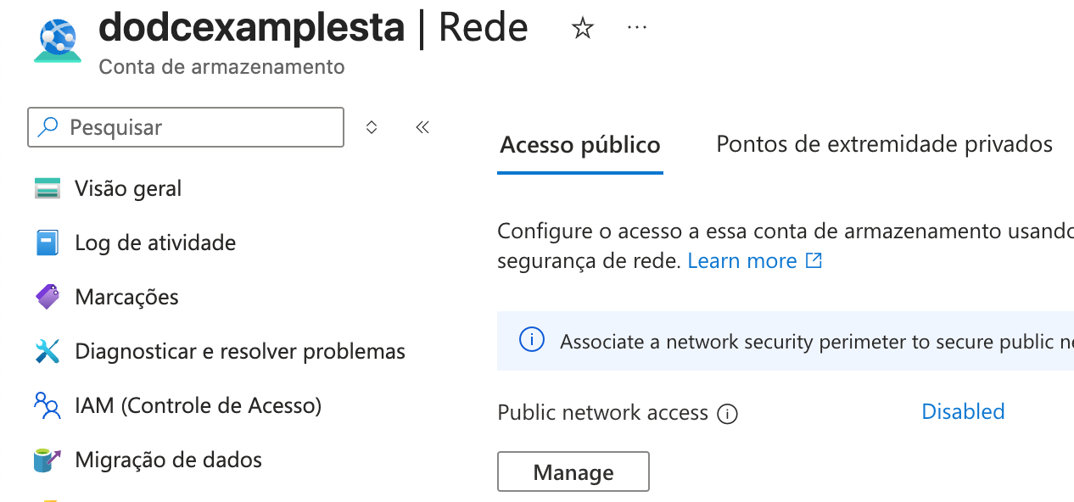
Managed resource based

Slide 26
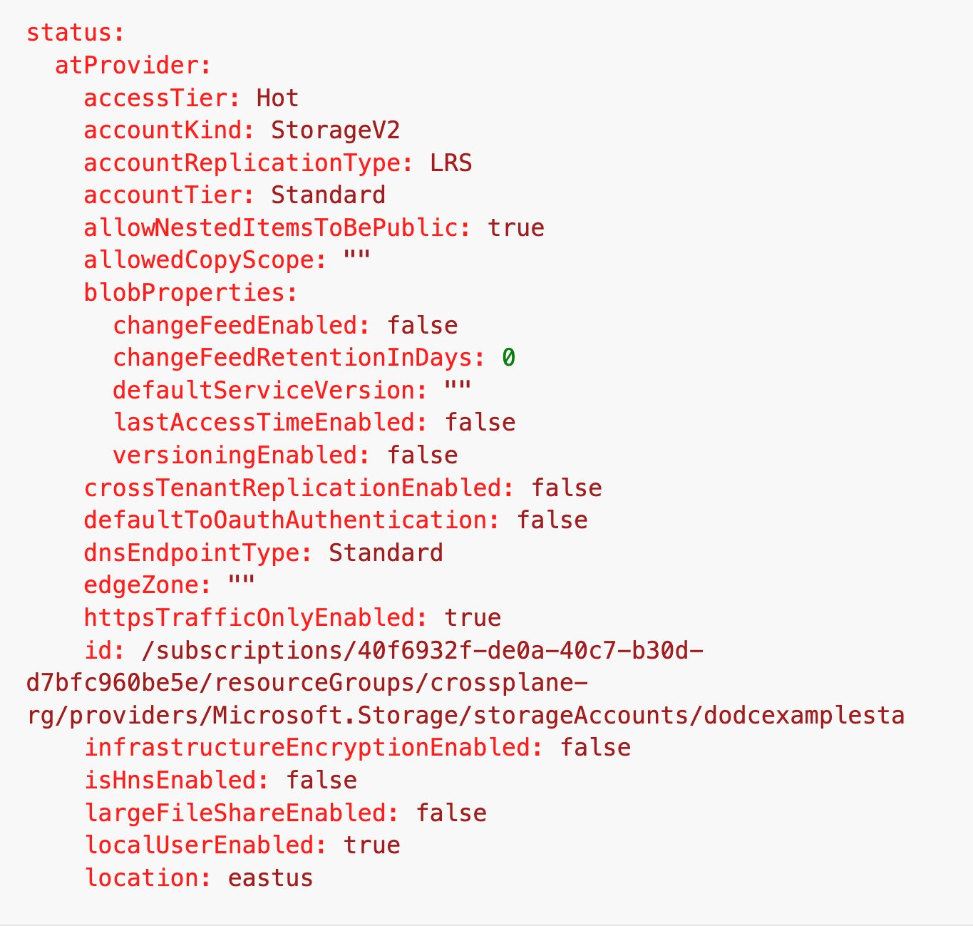
Managed resource based

Slide 27
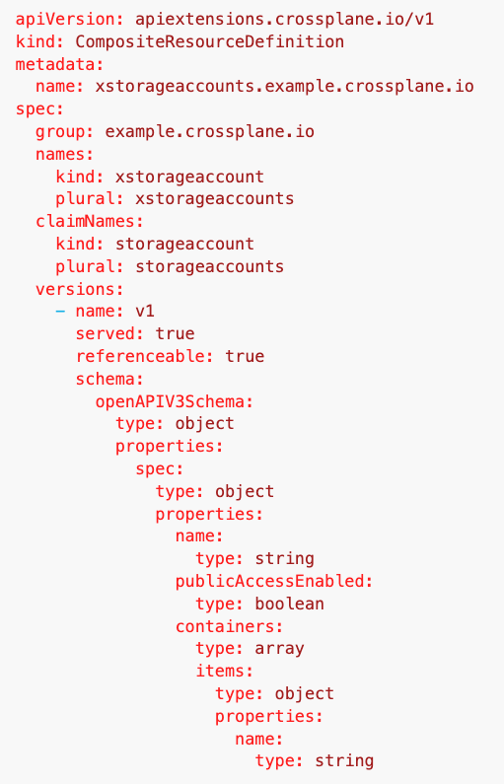
Composition based
XRD
Define o Schema da API (Composite Resource)
OpenAPIV3
Parâmetros que serão passados pro composition
Define a interface do Claim
Claim será deprecado na v2

Slide 28
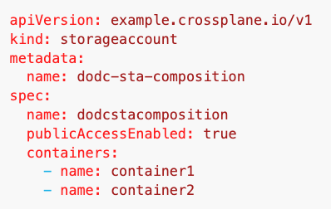
Composition based
Claim
Proxy para o Composite Resource
Claim será deprecado na v2

Slide 29
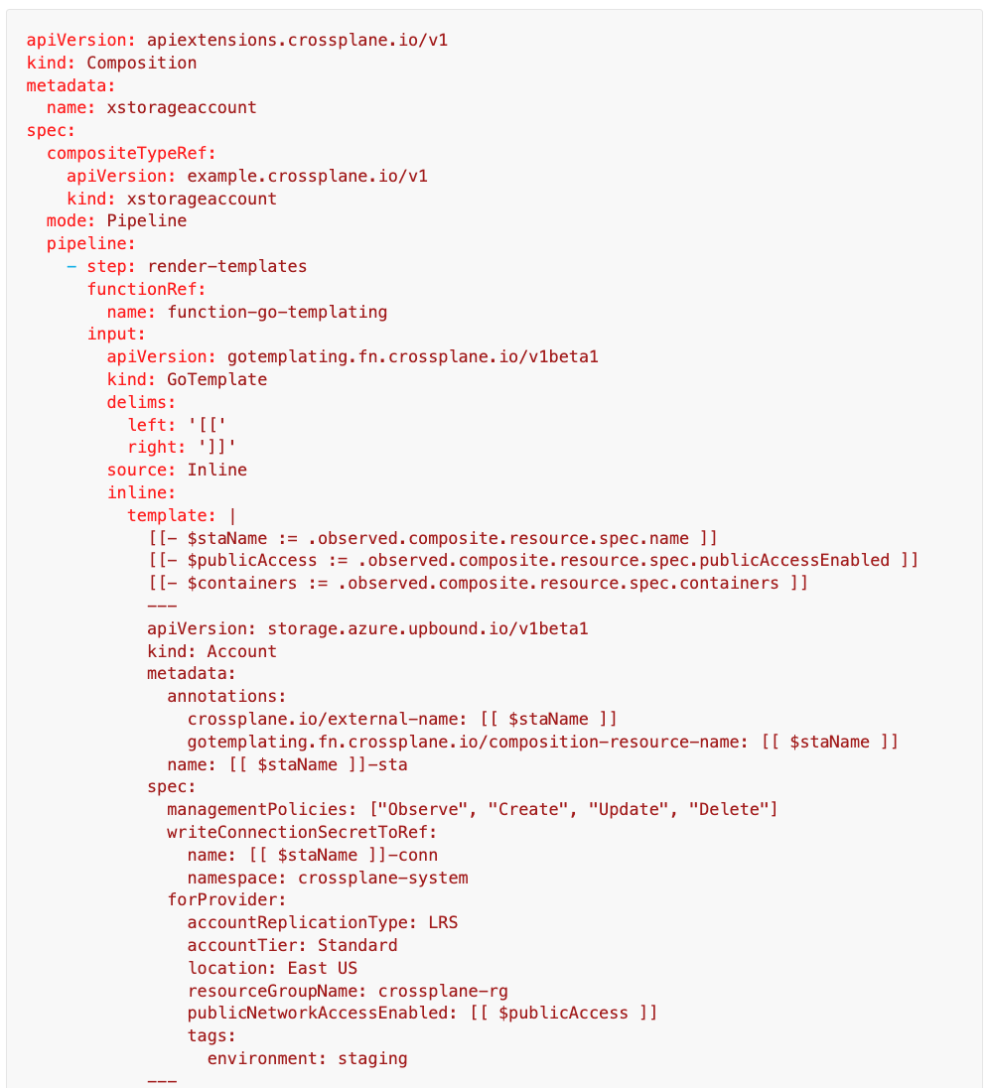
Composition based
Composition
Implementação da API
Pode criar vários recursos diferentes e de vários providers diferentes

Slide 30
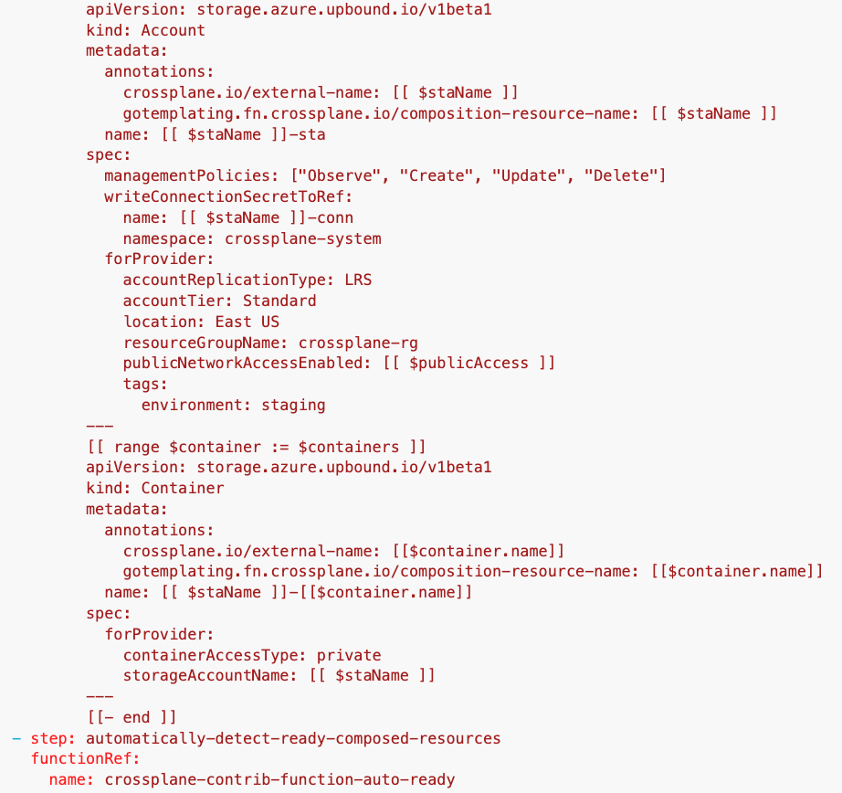
Composition based

Slide 31
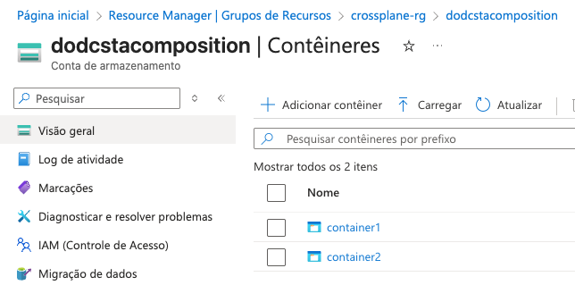
Composition based
Recursos criados
Storage Account
dodcstacomposition
Storage Container
container1
Storage Container
container2

Slide 32
XR e Claim - v1 vs v2
namespaced
Claim
User proxy
Composite Resource Definition (XRD)
Composite Resource
Composition
Define o Schema
Implementa a API
Instância da API
Managed Resource
Managed Resource
Managed Resource
Representação do Recurso
cluster-scoped
v1

Slide 33
XR e Claim - v1 vs v2
Composite Resource Definition (XRD)
Composite Resource
Composition
Define o Schema
Implementa a API
Instância da API
Managed Resource
Managed Resource
Managed Resource
Representação do Recurso
namespaced by default
v2

Slide 34
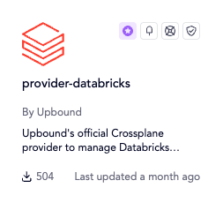
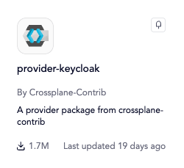
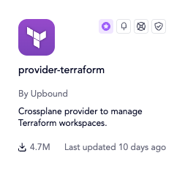
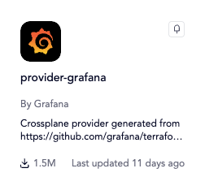
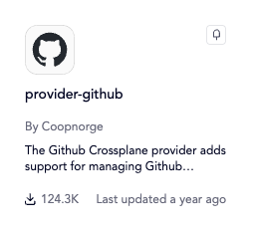
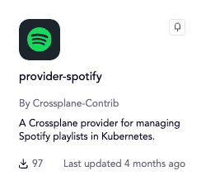
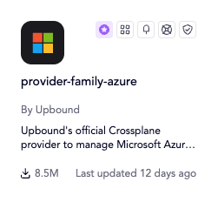
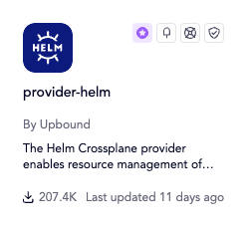
CrossPlane Providers
Estendendo a solução!

Slide 35
Provider 101
Source of Truth Flow
kubernetes cluster
Managed Resource
spec.forProvider
status.AtProvider
Provider Controller
Aplica
Recupera Status
Cloud Provider

Slide 36
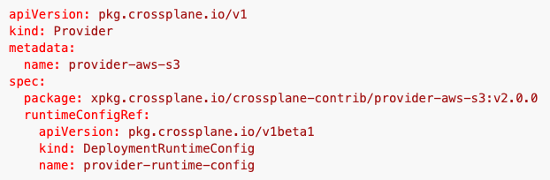
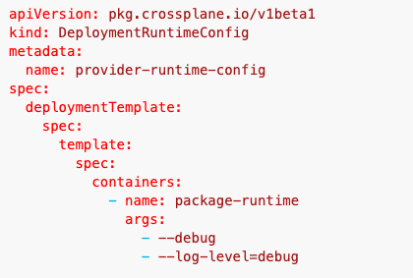
Provider 101
Parâmetro | Default
--max-reconcile-rate | 10 (reconcile/s)
--poll-interval | 1m (resource polling)
--sync-period | 1h (full sync)

Slide 37
Provider Pods
kubernetes cluster
External Resources
crossplane-system
Controller Logic
External Resource API
Package Manager
Instala
Provider Pod
API Server
Gerencia
Mapeia
Instala

Slide 38
Providers - v1 vs v2
Full Provider
Provider Family
Provider AWS
Provider AWS Family
MR Definitions (900+)
Subconjunto de CRDs
API Server
API Server
v1

Slide 39
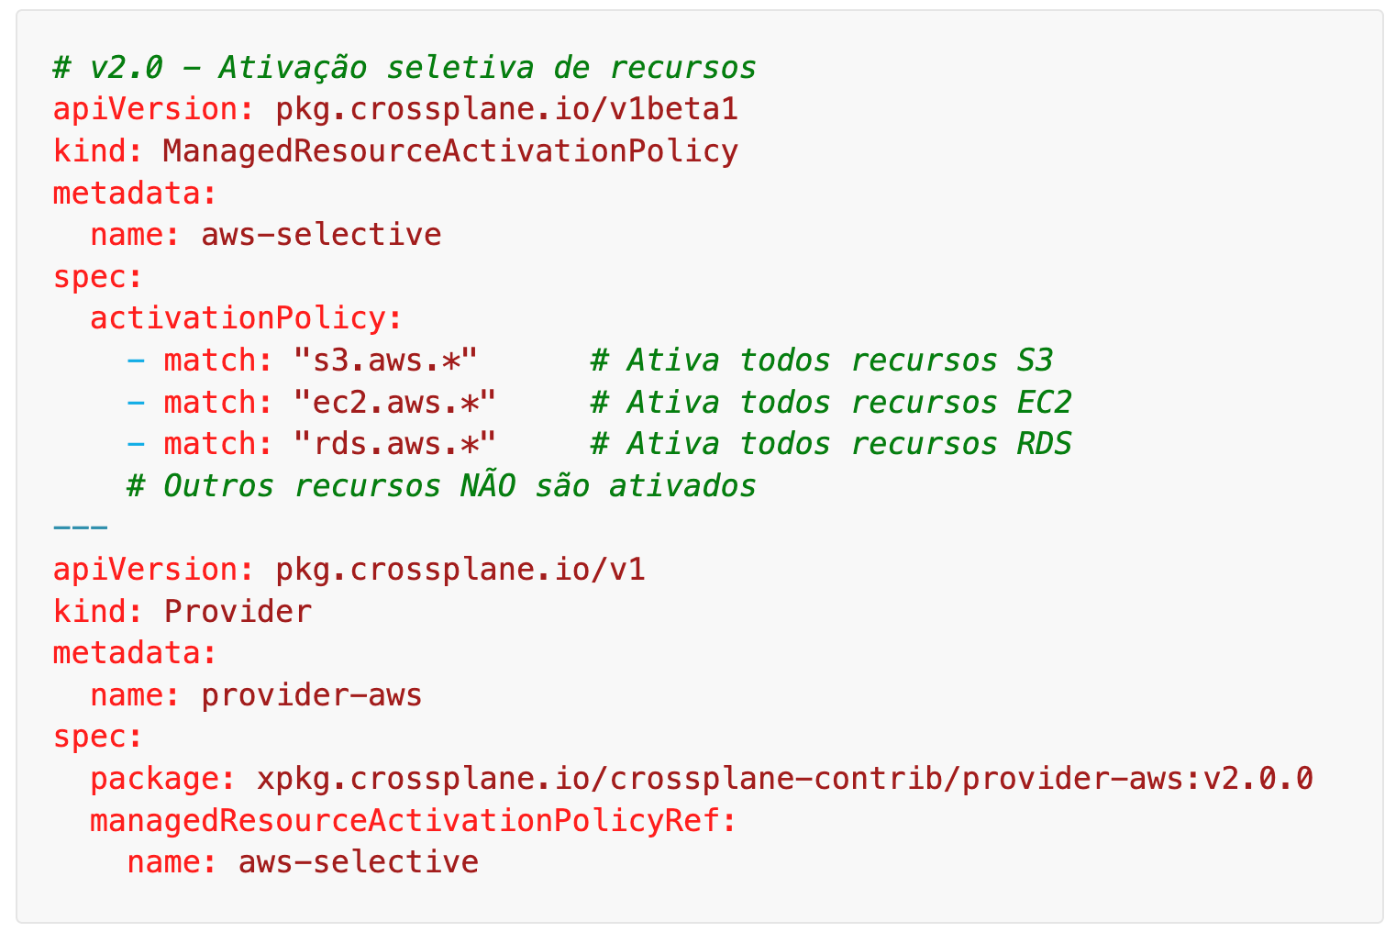
Providers - v1 vs v2
Activation Policy
Provider AWS
MR Definitions (900+)
50 CRDs Ativados
API Server
v2

Slide 40

CrossPlane Use Cases
Aplicando no dia a dia!

Slide 41


Environment Promotion

Slide 42

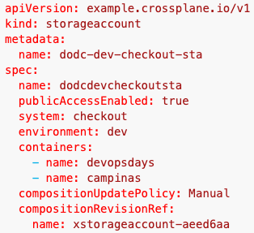
Environment Promotion
ApplicationSet
infra-resources 📁checkout 📁 dev 📄keyvault.yaml 📄app01.yaml 📄storage.yaml

Slide 43
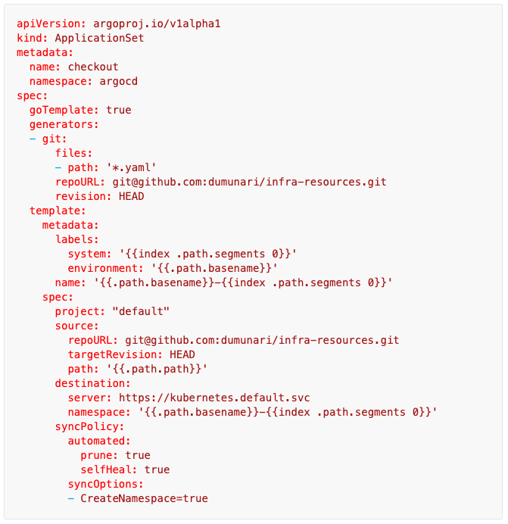
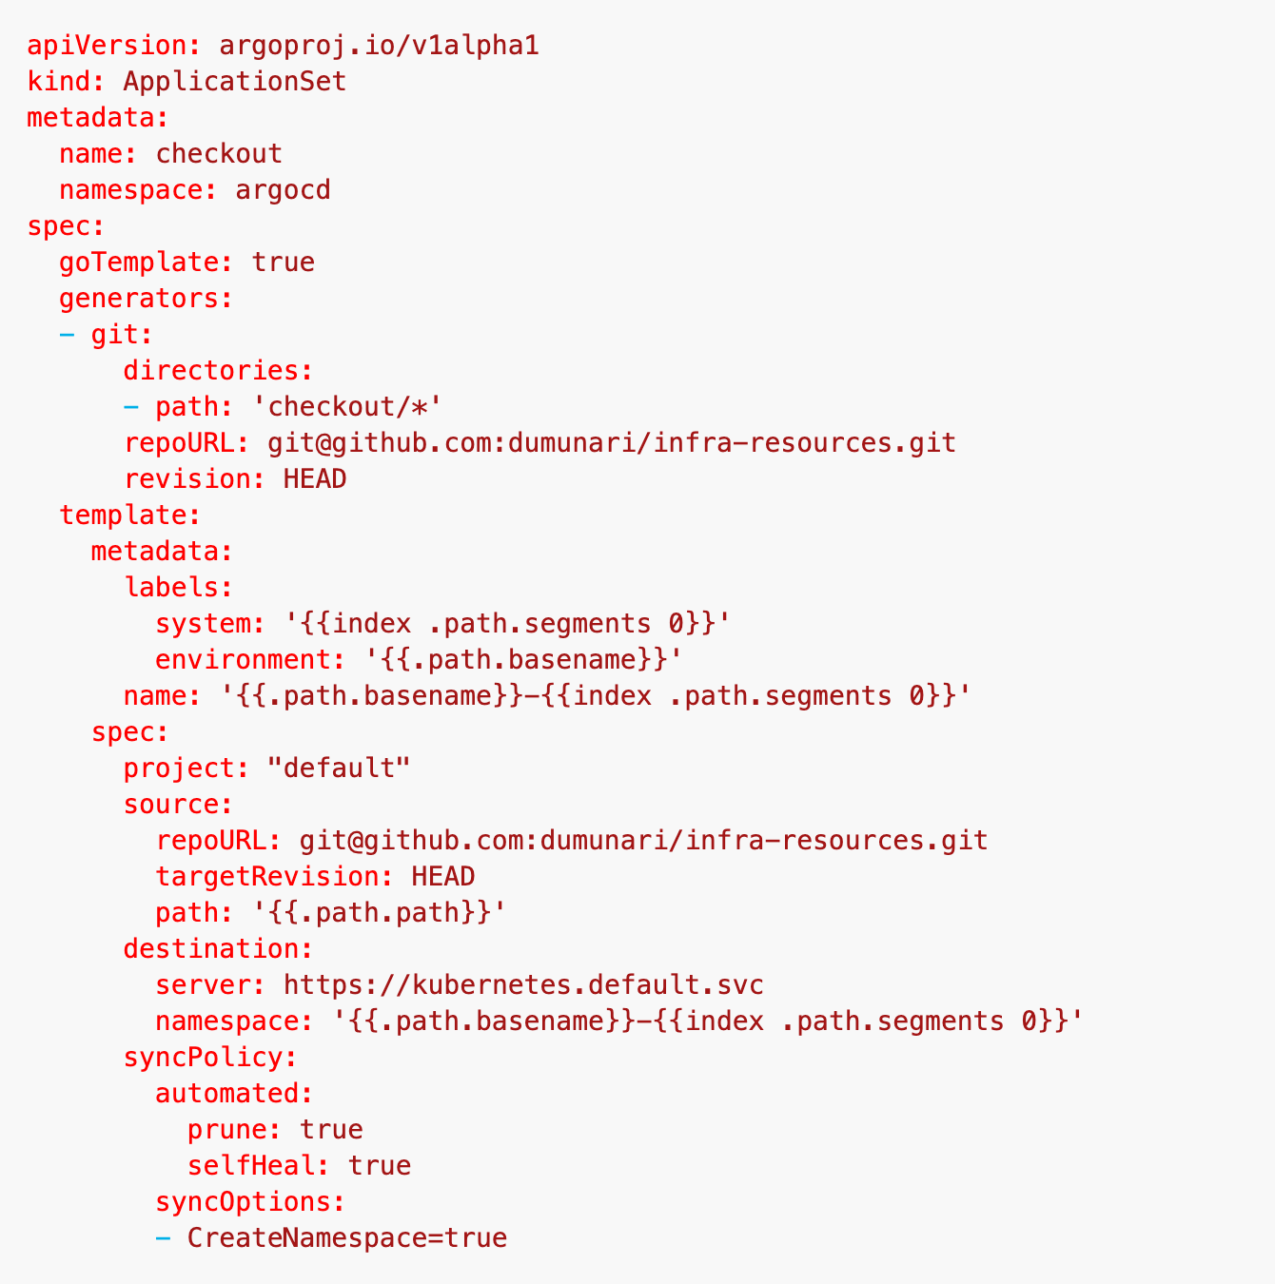
Environment Promotion

Slide 44
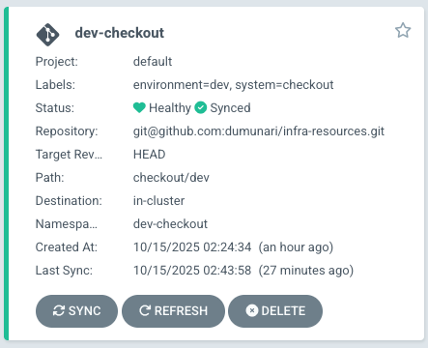
Environment Promotion

Slide 45
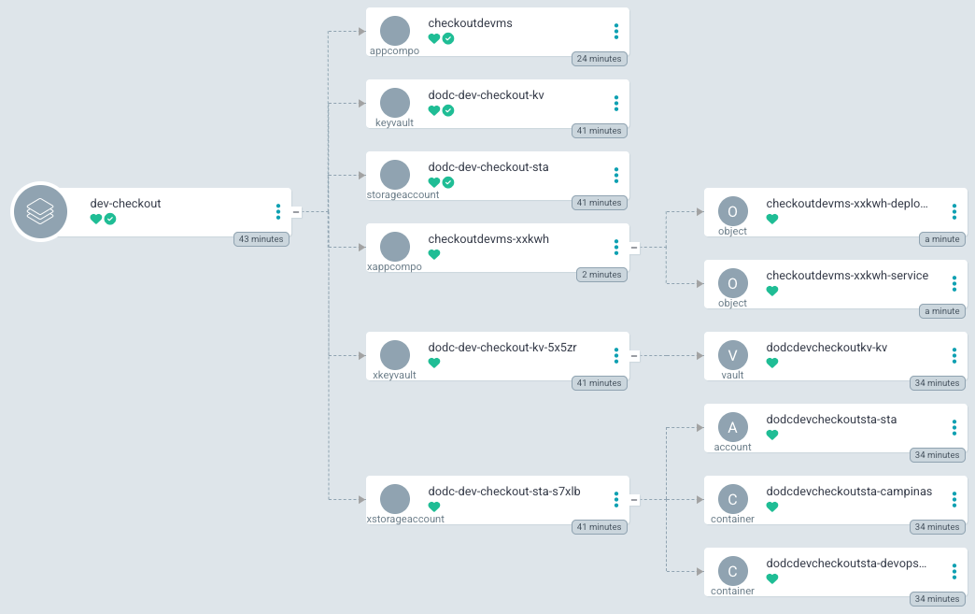
Environment Promotion

Slide 46
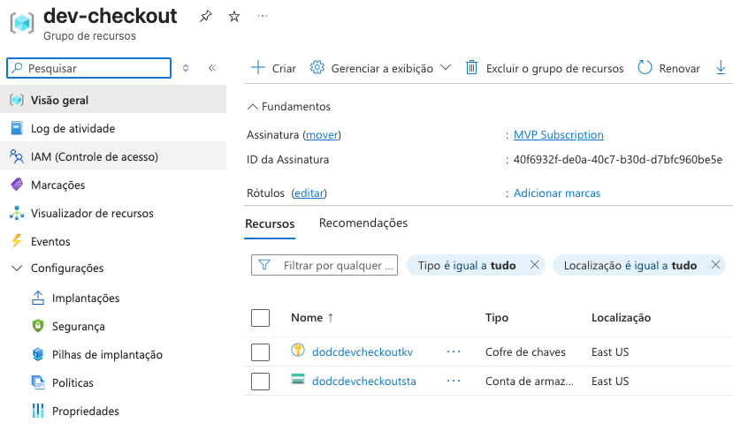

Environment Promotion

Slide 47
Environment Promotion
ApplicationSet
infra-resources 📁checkout 📁 dev 📄keyvault.yaml 📄app01.yaml 📄storage.yaml 📁 hom 📄keyvault.yaml 📄app01.yaml 📄storage.yaml

Slide 48
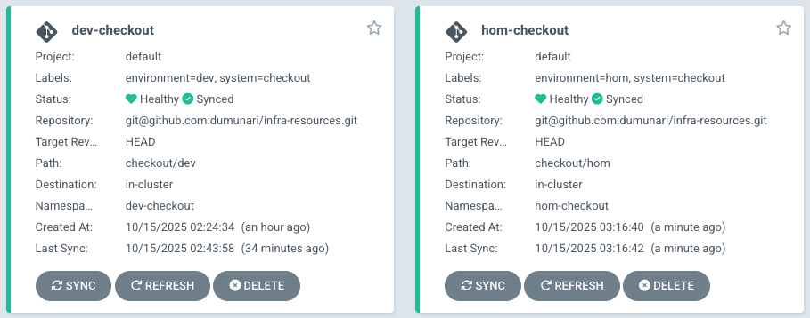
Environment Promotion

Slide 49
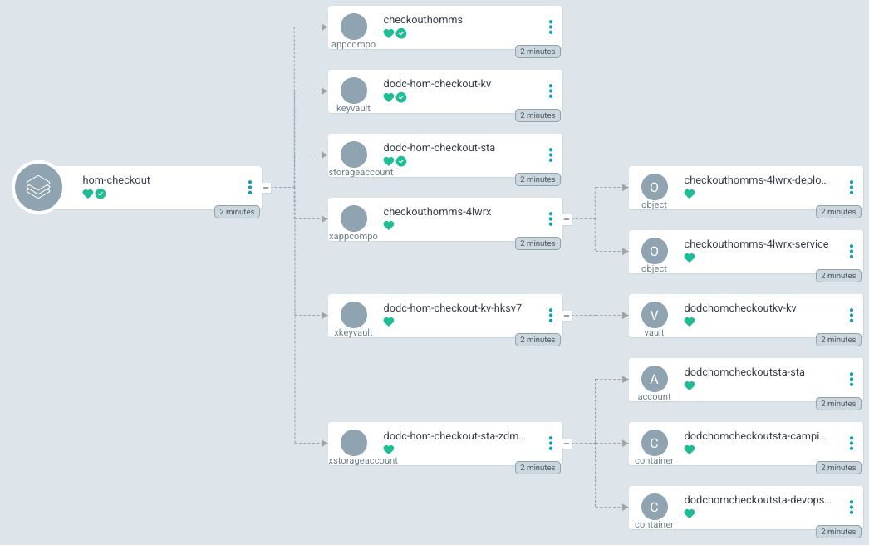
Environment Promotion

Slide 50
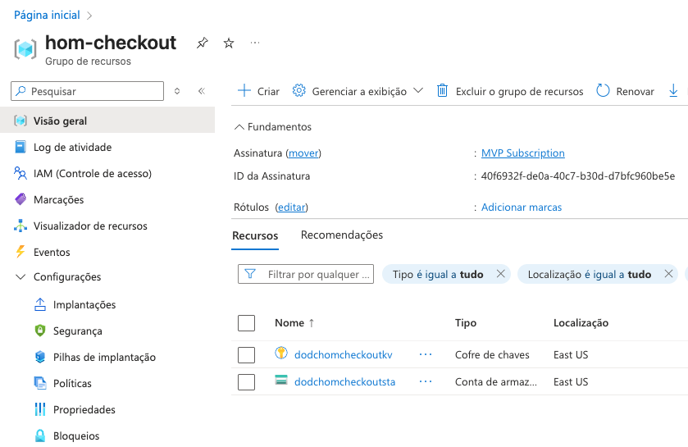

Environment Promotion

Slide 51
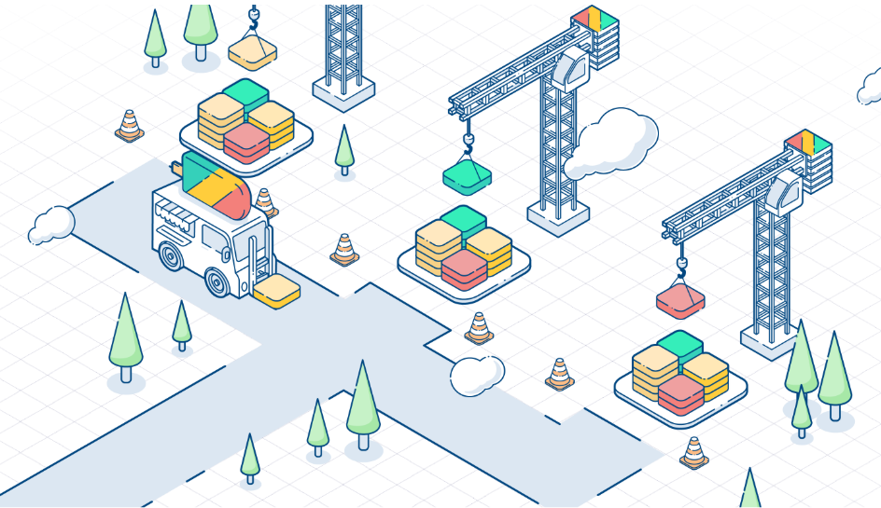
Environment Config

Slide 52
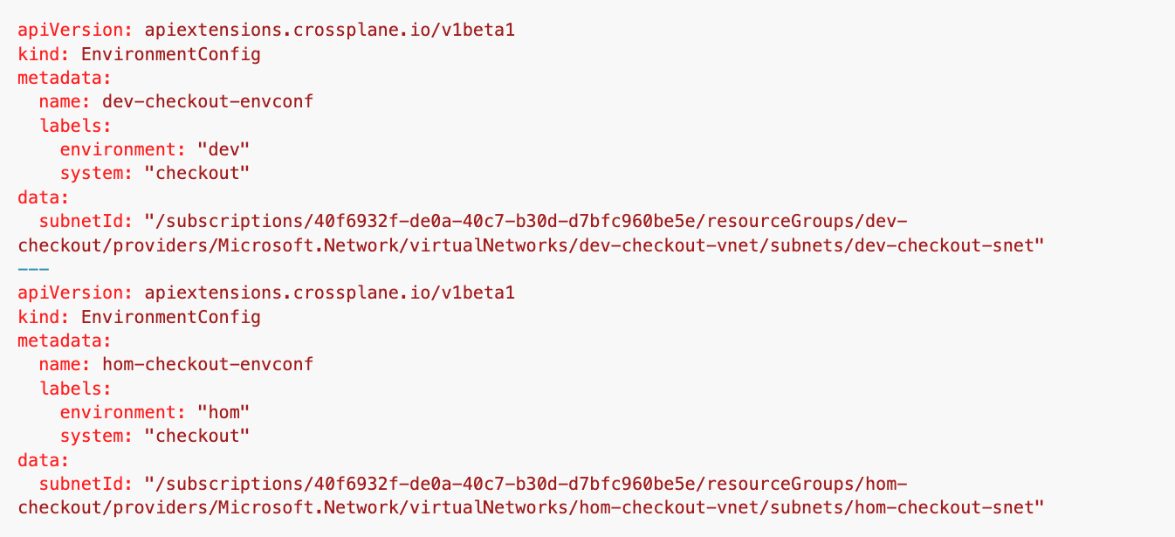
Environment Config

Slide 53
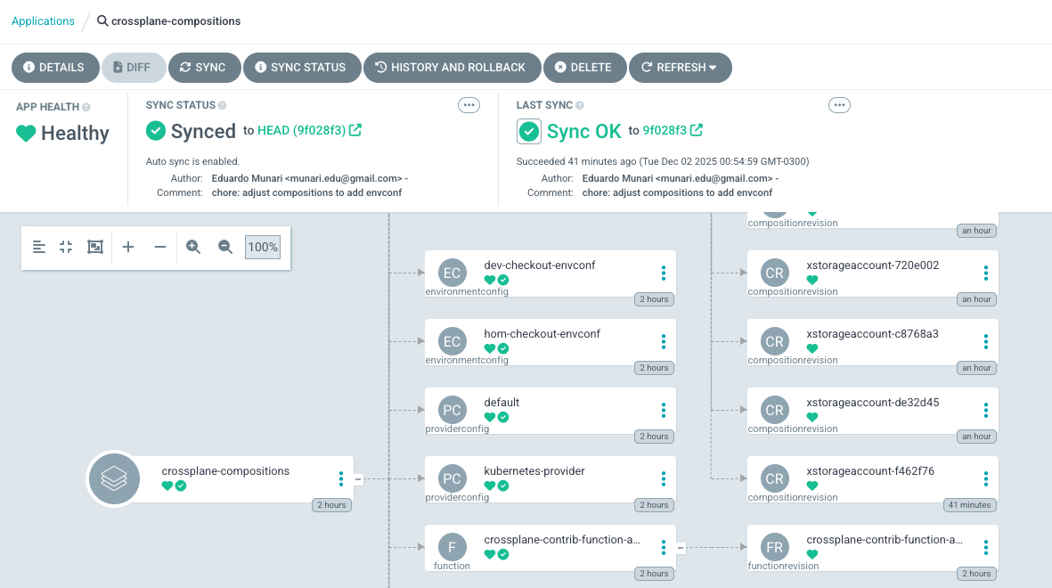
Environment Config

Slide 54
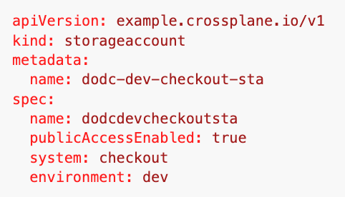
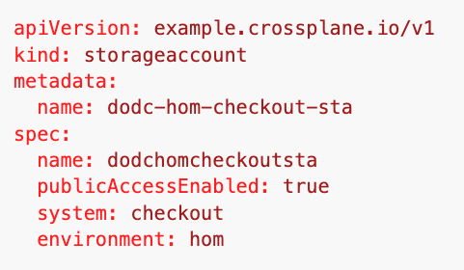
Environment Config
ApplicationSet
infra-resources 📁checkout 📁 dev 📄keyvault.yaml 📄app01.yaml 📄storage.yaml 📁 hom 📄keyvault.yaml 📄app01.yaml 📄storage.yaml

Slide 55

Environment Config

Slide 56

Environment Config

Slide 57

Environment Config

Slide 58

Environment Config

Slide 59

Environment Config

Slide 60

Environment Config

Slide 61

Environment Config

Slide 62

Environment Config

Slide 63

Environment Config

Slide 64

Environment Config

Slide 65

Environment Config

Slide 66

Environment Config

Slide 67

Environment Config

Slide 68

Environment Config

Slide 69

Environment Config

Slide 70
Monitoring Crossplane
Lidando com a escala!

Slide 71

Monitoring Crossplane

Slide 72

Monitoring Crossplane

Slide 73

Monitoring Crossplane

Slide 74
Obrigado!

